Slide 1


Subject Code: SIT-1205
Subject Name: Object Oriented Analysis and Design
Faculty Name: Dr.R.Jeberson Retna Raj
Dr.R.M Gomathi

Slide 2
UNIT 3 OBJECT ORIENTED ANALYSIS
Business Object Analysis - Use Case Driven Object Oriented Analysis - Business Process Modeling - Use Case model - Developing Effective Documentation - Object Analysis Classification: Classification Theory - Noun Phrase Approach - Common Class Patterns Approach - Use-Case Driven Approach - Classes Responsibilities and Collaborators - Naming Classes - Identifying Object Relationships, Attributes and Methods: Association - SuperSubclass Relationships - A-part of Relationships.
.

Slide 3
Analysis
Objective of Analysis
To capture a complete unambiguous, and consistent picture of the requirements of the system.
What the system must do to satisfy the user’s requirements and needs.
Analysis is a process of transforming a problem definition from a fuzzy set of facts and myths into a coherent statement of system’s requirements.
Transformation of the users needs into set of problem statements and requirements.
How the users will use the system
What is needed to accomplish the system’s operational requirements.
Analysis involves a great deal of interaction with the people who will be affected by the system.

Slide 4
Analysis
Analyst use Four major tools for extacting information about the system
Examination of existing system documentation
Interviews
Questionnaire
Observation
Miner methods
Literature review
Input is user requirements(written and oral)
Output is model
Analyst concerns uses of the system, identifying objects and inheritance, events that change state of objects.

Slide 5
Analysis
The designer adds detail to this model → designing screens, user interaction, and database access.

Slide 6
Analysis
Reason for Analysis is a Difficult Activity:
Analysis is a creative activity that involves understanding the problem, its associated constraints, and methods of overcoming those constraints.
This is an iterative process that goes on until the problem is well understood. Norman explains the three most common sources of requirement difficulties:
Fuzzy descriptions
Incomplete requirements
Unnecessary Features

Slide 7
Analysis
1. Fuzzy descriptions - such as "fast response time" or "very easy and very secure updating mechanisms." A requirement such as fast response time is open to interpretation, which might lead to user dissatisfaction if the user's interpretation of a fast response is different from the systems analyst's interpretation
2. Incomplete requirements - mean that certain requirements necessary for successful system development are not included for a variety of reasons.
These reasons could include the users' forgetting to identify them, high cost, politics within the business, or oversight by the system developer.
However, because of the iterative nature of object oriented analysis and the unified approach most of the incomplete requirements can be identified in subsequent tries.

Slide 8
Analysis
3. Unnecessary features - When addressing features of the system, keep in mind that every additional feature could affect the performance, complexity, stability, maintenance, and support costs of an application.
Features implemented by a small extension to the application code do not necessarily have a proportionally small effect on a user interface.
Analysis is a difficult activity. You must understand the problem in some application domain and then define a solution that can be implemented with software.
Experience often is the best teacher. If the first try reflects the errors of an incomplete understanding of the problems, refine the application and try another run.

Slide 9
BUSINESS OBJECT ANALYSIS:
Business object analysis is a process of understanding the system's requirements and establishing the goals of an application.
The main intent of this activity is to understand users' requirements.
The outcome of the business object analysis is to identify classes that make up the business layer and the relationships that play a role in achieving system goals.

Slide 10
Developing Business Processes
Developing an activity diagram of the business processes can provide us with an overall view of the system.
Notes:
Business process modeling can be very time consuming, so the main idea should be to get a basic model without spending too much time on the process. The advantage of developing a business process model is that it makes you more familiar the system and therefore the user requirements and also aids in developing use cases.

Slide 11
Business object analysis: understanding the business layer
Understanding user requirements to set goals of system development.
Identifying classes and relationships
Use cases are used to understand system requirements.
Understanding input and output
What must be done and how it should be done
Preparing prototype of an user interface
Its valuable tool used in business analysis to understand well
Once the user requirements are identified, those things need to be documented to proceed with design and implementation.
This is an iterative process.

Slide 12
Use Case Model
Use cases are scenarios for understanding system requirements.
The use-case model describes the uses of the system and shows the courses of events that can be performed.
Some Definitions
User – Human Users + Other Systems
Use Case – A piece of functionality
Use-Case Model – All the use cases
Use-Case Driven – Development process follows a flow

Slide 13
Use case Driven
Product development is Use case driven:
Capture the user’s needs (requirements - in users context)
- Helps in Project Scheduling
Analyse to specify the needs
Design to realize the needs
Implement to implement the needs
Test to verify the needs
Verified by
Implemented by
Realized by
Use cases
Test
Specified by
Implementation
Design
Analysis

Slide 14
Use case modeling
Use cases are scenarios for understanding system requirements.
Use case is an interaction between users and a system.
It represents the goal of the user and the responsibility of the system to its users.
Also describes uses of the system and the set of events that can be performed by the system.
Use case must have a name and short textual representation of not more than few paragraphs.

Slide 15
Use Case Model (Con’t)
Use case defines what happens in the system when a use case is performed.
The use-case model tries to systematically identify uses of the system and therefore the system's responsibilities.

Slide 16
Use-case driven object-oriented analysis: The unified approach
OOA phase of the unified approach uses actors and use cases to describe the system.
The actor is an external factors that interact with the system.
Use cases are scenarios that describes how actors use the system.

Slide 17
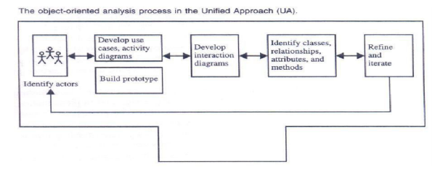
Use case Driven Object Oriented Analysis: The Unified Approach

Slide 18
OOA process steps
Identify the actors:
Who is using the system
For new system, who is going to use the system
Develop a simple business process model using UML activity diagram
Develop the use case:
What are the users doing with the system
Or, what will users be doing with the system
Use cases provide us with documentation of the system under study

Slide 19
Analysis
Prepare interaction diagrams:
Determine the sequence
Develop collaboration diagrams
Classification: develop UML class diagram:
Identify classes
Identify relationships
Identify attributes
Identify methods
Iterate and refine: if needed repeat the steps

Slide 20
Use cases under the microscope
Definition given by jacobson:
A use case is a sequence of transactions in a system whose task is to yield results of measurable value to an individual actor of the system.

Slide 21
Use Cases Under the Microscope
"A Use Case is a sequence of transactions in a system whose task is to yield results of measurable value to an individual actor of the system."
What is a
Use Case
again?

Slide 22
Use Case Key Concepts
Use case. Use case is a special flow of events through the system.
Actors. An actor is a user playing a role with respect to the system.
In a system. This simply means that the actors communicate with the system's use case.
Notes:
Remember, when dealing with actors, it is important to think about roles rather than just people and their job titles.

Slide 23
Use Case Key Concepts (Con’t)
A measurable value. A use case must help the actor to perform a task that has some identifiable value.
Transaction. A transaction is an atomic set of activities that are performed either fully or not at all.

Slide 24
Use Associations
The use association occurs when you are describing your use cases and notice that some of them have common subflows.
The use association allows you to extract the common subflow and make it a use case of its own.
Notes:
A use-case description can be difficult to understand if it contains too many alternatives or exceptional flows of events that are performed only if certain conditions are met as the use-case instance is carried out. A way to simplify the description is to take advantage of extends and uses associations. The extends and uses associations often are sources of confusion, so let us take look at these relationships.

Slide 25
Extends Associations
The extends association is used when you have one use case that is similar to another use case but does a bit more or
Is more specialized; in essence, it is like a subclass.

Slide 26
Notes:
The similarity between extends and uses associations is that both can be viewed as a kind of inheritance. When you want to share common sequences in several use cases utilize the uses association by extracting common sequences into a new, shared use case. The extends association is found when you add a bit more specialized, new use case that extends some of use cases that you have.

Slide 27
Contn..
1.Use-case name: Borrow books. A member takes books from the library to read at home, registering them at the checkout desk so the library can keep track of its books. Depending on the member's record, different courses of events will follow.
2.Use-case name: Get an interlibrary loan. A member requests a book that the library does not have. The book is located at another library and ordered through an interlibrary loan.
3.Use-case name: Return books. A member brings borrowed books back to the library.
4.Use-case name: Check library card. A member submits his or her library card to the clerk, who checks the borrower's record.

Slide 28
Contn..
5. Use-case name: Do research. A member comes to the library to do research. The member can search in a variety of ways (such as through books, journals, CDROM, WWW) to find information on the subjects of that research.
6. Use-case name: Read books, newspaper. A member comes to the library for a quiet place to study or read a newspaper, journal, or book.
7. Use-case name: Purchase supplies. The supplier provides the books, journals, and newspapers purchased by the library.

Slide 29
Fully Developed Use Case Description
Use Case Name: | Checkout Movies
Scenario: | Checkout movies at counter
Triggering Event: | Customer brings movies to checkout counter
Brief Description: | When customer brings movies to counter, clerk checks membership ID, clerk scans in each movie identifier, takes payment, and notifies customer of return due date and time.
Actors: | Video clerk
Related Use Cases: | Add new member
Stakeholders: | Clerk, Store manager
Preconditions: | Movie titles must exist Movie copy must exist Customer must exist (or Add new member must be invoked)
Postconditions: | Video Rental and rental line items must be created Payment transaction must be created Status of movie copy must be updated Video Rental must be connected to customer family member

Slide 30
Identifying the use cases: Goals
The use-case approach to object-oriented analysis and the object-oriented analysis process.
Identifying actors.
Identifying use cases.
Documentation.

Slide 31
Key words of the use case
Use case:
Flow of events.
Many courses of events can be grouped together.
Many use cases can be grouped together to manage complexities and to reduce number of use cases.
Ex:
Borrowing the book depends on whether book is available and whether you are the member of the library.
Simple use cases can be grouped together.

Slide 32
Contn…
Actors:
An actor is the user who uses the system.
A single actor can perform many use cases.
A single use case can have many actors.
An actor can be an external system which needs some information from the system.
A measurable value:
A use case must help the actor to perform a task that has some identifiable value.
The performance of the use case in terms of cost or price
Transaction:
An atomic set of activities performed either fully or not at all.
Can be triggered by the user or any other external system.

Slide 33
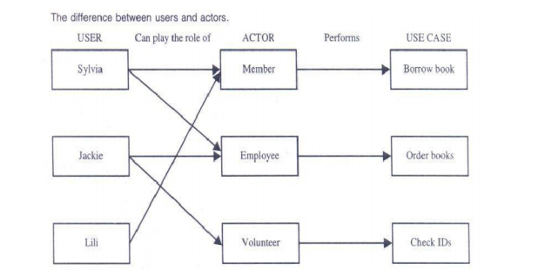
Identifying the actors
Actor represents the role a user plays with respect to the system.
A user must play more than one role
A person can be member of an library and also a customer of a bank.
We have to identify the actors and the interaction with the system.

Slide 34
Identifying the actors
Actors can be found through:
Who is using the system? or who is affected by the system? Or which group need help from the system to perform a task?
Who affects the system? Or which user groups are needed by the system to perform its functions?
Which external hardware or other system use the system?
What problems does this application solve?
Finally, how do users use the system?
What are they doing with the system?

Slide 35
Identifying the actors
An actor need not to be human.
An actor also can be an external system.

Slide 36
Guidelines for finding use cases
Steps:
For each actor. Identify the tasks that actor can able to perform or the system expects the task from that actor.
Name the use cases
Describe the use case with user familiar terms.
Actors represent a role that one or several users can play
Ex: employee is an actor.John,Ram..are users

Slide 37
Guidelines for finding use cases
Each use case should have only one main actor. To achieve this,
Isolate users from actors
Isolate actors from other actors
Isolate use cases that have different initiating actors and slightly different behavior.

Slide 38
Dividing Use Cases into Packages
Dividing Use Cases into Packages Each use case represents a particular scenario in the system.
You may model either how the system currently works or how you want it to work. A design is broken down into packages. You must narrow the focus of the scenarios in your system.
For example, in a library system, the various scenarios involve a supplier providing books or a member doing research or borrowing books.
In this case, there should be three separate packages, one each for Borrow books, Do research, and Purchase books.
Many applications may be associated with the library system and one or more databases used to store the information (see Figure).

Slide 39
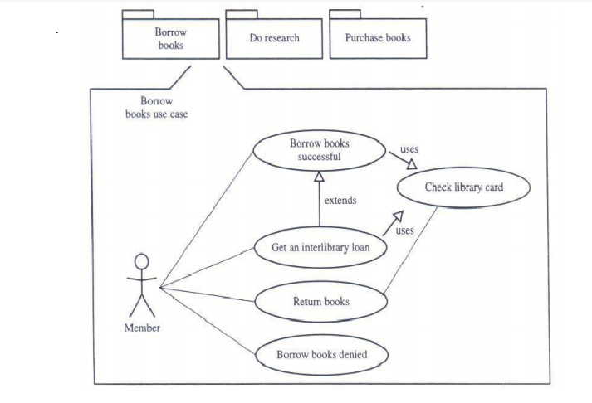
Dividing Use Cases into Packages

Slide 40
Naming a use case
Should provide a general description of the use-case model.
The name should describe what happens.
Name should be active
Name should be verb(Borrow) or verb and noun (Borrow books).
The description should be consistent.

Slide 41
Developing effective documentation
Documentation give clarity about the system also that reveal issues and gaps in the analysis and design.
It’s the communication tool among developers.
Initial understanding of the requirements.
Main issue in documentation during analysis is to determine what the system must do.
How the system works are delayed till design.

Slide 42
Developing effective documentation
The questionnaire raised by blum for better documentation:
How will the document be used?
What is the objective?
What is the management view?
Who is going to read this document?

Slide 43
Organization conventions for documentation
It depends on the organizations rules and regulations.
Organizations have established standards and conventions
Bell and Evans provided a template for the documentation

Slide 44
Organization conventions for documentation
Recommended by Bell and Evans
Common cover:
All documents should share a common cover sheet that identifies the document, the current version and the individual responsible for the content.
The changes in the individual responsibility should be reflected in the cover.
80-20 rule:
80 percent of the work can be done with 20 percent of the documentation.

Slide 45
Organization conventions for documentation
Familiar vocabulary:
Use the vocabulary that your readers understands.
Make the document as short as possible:
Repetition should be removed.
Presents summaries, reviews, organization chapters in less than three pages.
The chapter headings should be task oriented so that the table of contents can be an index.

Slide 46
Organization conventions for documentation
Organize the document:
Good organization of each section with consistent format.
(Document name)
For
(Product)
(version Number)
Responsible individual
Name:
Title:

